Slide 1
Minor Project on Information System of I.T. department of NEHU(ISITNEHU)
Under Supervision of: Hemanta Kumar Kalita Associate Professor, Information Technology

Slide 2
Group Members:
Brandon Victor Syiem(BT/IT/1013)
Devika Paul(BT/IT/1016)
Hazel Nicolette Manners(BT/IT/1020)
Prasanta Kalita(BT/IT/1044)
Ronald Ashley Dkhar(BT/IT/1064(L))

Slide 3
Problem Definition
The definition of our problem lies in manual system and a fully automated system.
Current System:
The system is very time consuming and lazy.
Proposed System:
The technical systems is fast, accurate, user-friendly and reliable.

Slide 4
Objective
The main aim of this project is to develop
“Information System of IT dept,NEHU(ISITNEHU)” to provide an
easy way to automate all functionalities involved in managing
students’ details , marks management , attendance sheet
generation and admit card generation.

Slide 5
Need of ISITNEHU(Information System of I.T. department of NEHU)
A few factors that direct us to develop a new system are given below -:
Faster System
Accuracy
Reliability
Informative
Attendance Sheet Generation
Marks Management
Admit Card generation

Slide 6
Introduction
Student Details, Marks Management, Admit card generation
and attendance sheet generation can be instantly done with very
minimum effort required for the task, providing stress-free
solution to the teachers and clerk of the IT Department.
Marks can now be entered through the “ISITNEHU”. The clerk can
generate admit cards of all students in an automated way. This
system allows 24-hour assistance to access student records and
to make the marks submission process for teachers more
efficient.

Slide 7
Benefits
To improve the efficiency.
To provide easy and faster generation of Admit Card.
To quickly find out student details and marks.
To provide user friendly environment.
To provide an easy and fast way to generation attendance sheets.

Slide 8
Functional Requirements
Common
This module helps to view the Basic students Information.
Clerk
This module helps to view and print the admit cards details. It also helps to generate admit cards and entry of new student details and Faculty details.
Teacher
This module helps in the entry of students marks and attendance, generate attendance sheet and assign students into their elective subject if the students opted for it.

Slide 9
Functional Requirements
Student
This module helps notify students of new Events and is under construction.
Admin
This is the master module and has the functionalities of all the other modules and also helps in managing the Access control of different users.

Slide 10
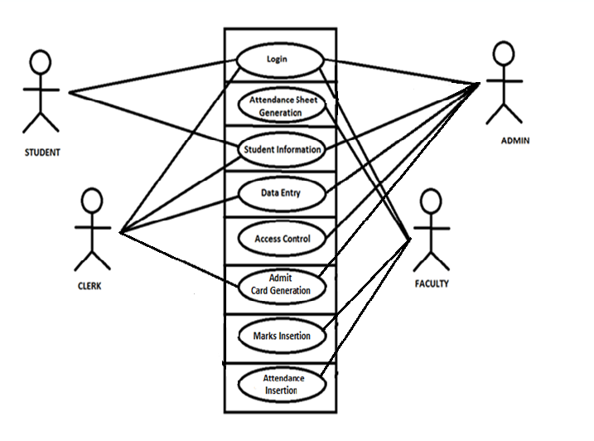
Use Case Diagram

Slide 11
Non-Functional Requirements
User interface
This software provides a friendly user interface for the front end which is self explanatory.
Hardware interfaces
Monitor
Mouse
Keyboard
Printer
Software interfaces
OS Windows XP and above versions.
Front End Web Browser
Back End MySQL
Communication interfaces Webpages

Slide 12
Entity Relationship Diagram

Slide 13
Relational Schema of database tables
Assessment(rollno, scode, revision year, eid, atn, internal, external, result);
Fee(rollno, payed);
Sessional(rollno, scode, revision year, s1,s2,s3,q1,q2,q3,a1,a2,a3, atn_marks, atn1, atn2, atn3);
Semester(batch,course,sem);
Subject(scode,revision year, course, sname, sem, total_merit, marks_ext, marks_int, marks_attd, marks_assgn, theory_practical);
Faculty(eid, efname, elname, phone_no, email_add, category, role);
Student(rollno, sid, batch, course, fname, lname, gender, dob, per_add, mail_add, contact, email, father_name, mother_name, guardian_name, guardian_contact, guardian_email, bloodgroup, nationality, religion, caste, marital_status, regno, regyear);

Slide 14
Relational Schema for Relationship Sets
Elects(rollno, elective no, sem, revision year,scode);
Repeats(rollno, scode, revision year, tries, applied);
Teaches(eid, scode, revision year);
Debarred(rollno, scode, revision year);
Midterm(rollno, scode, revision year, c1,c2,c3, atn_marks, atn1, atn2);
User(username, password, student_view, teacher_view, clerk_view, admin_view)

Slide 15
DATA FLOW DIAGRAMS

Slide 16
Context Level Diagram

Slide 17
Level 1 Diagram

Slide 18
Level 2 Diagrams

Slide 19
Level 2 Diagram Contd…

Slide 20
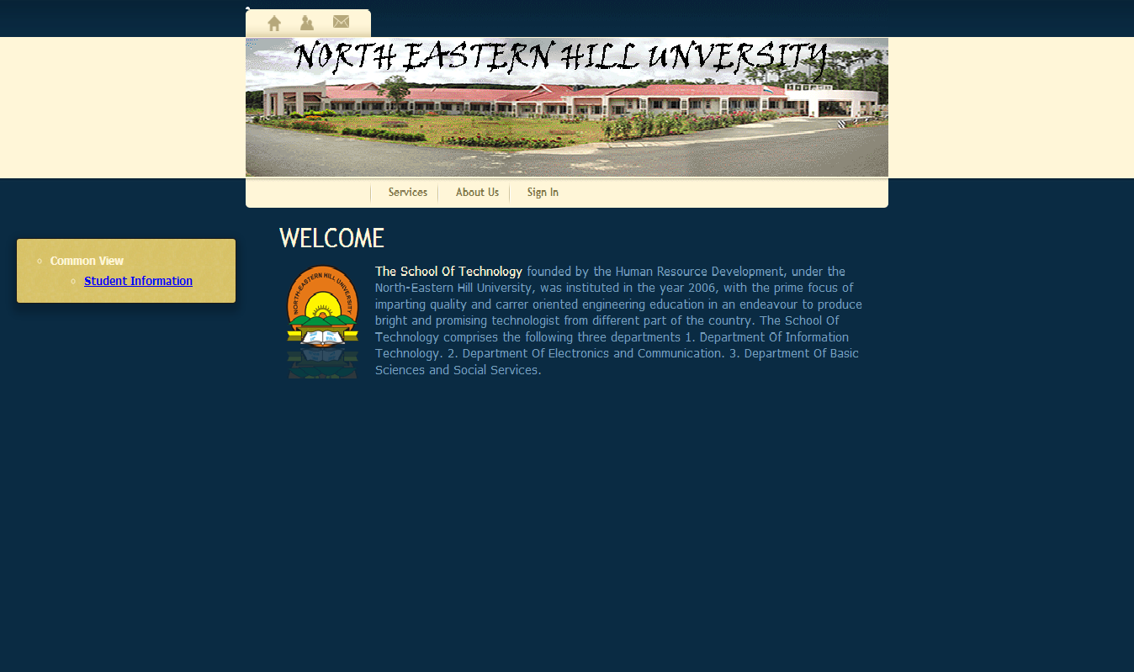
Home Page

Slide 21
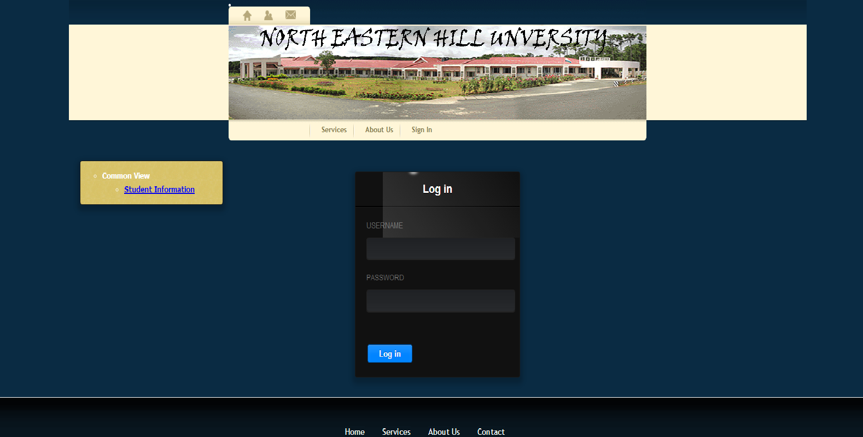
Login

Slide 22
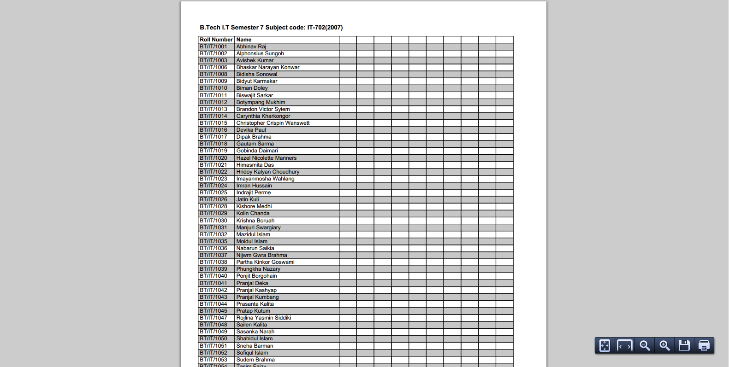
Attendance Sheet Generation

Slide 23
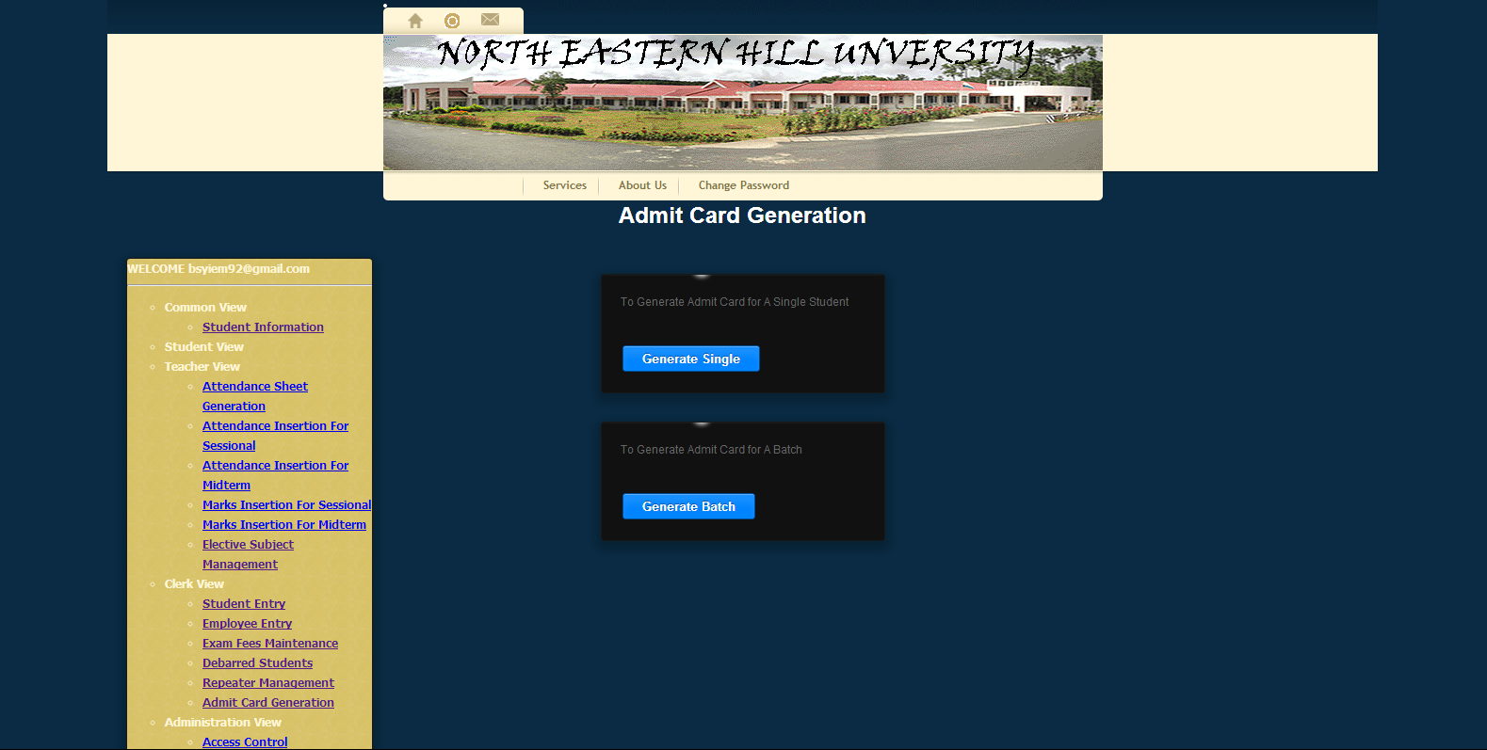
Admit Card Generation

Slide 24
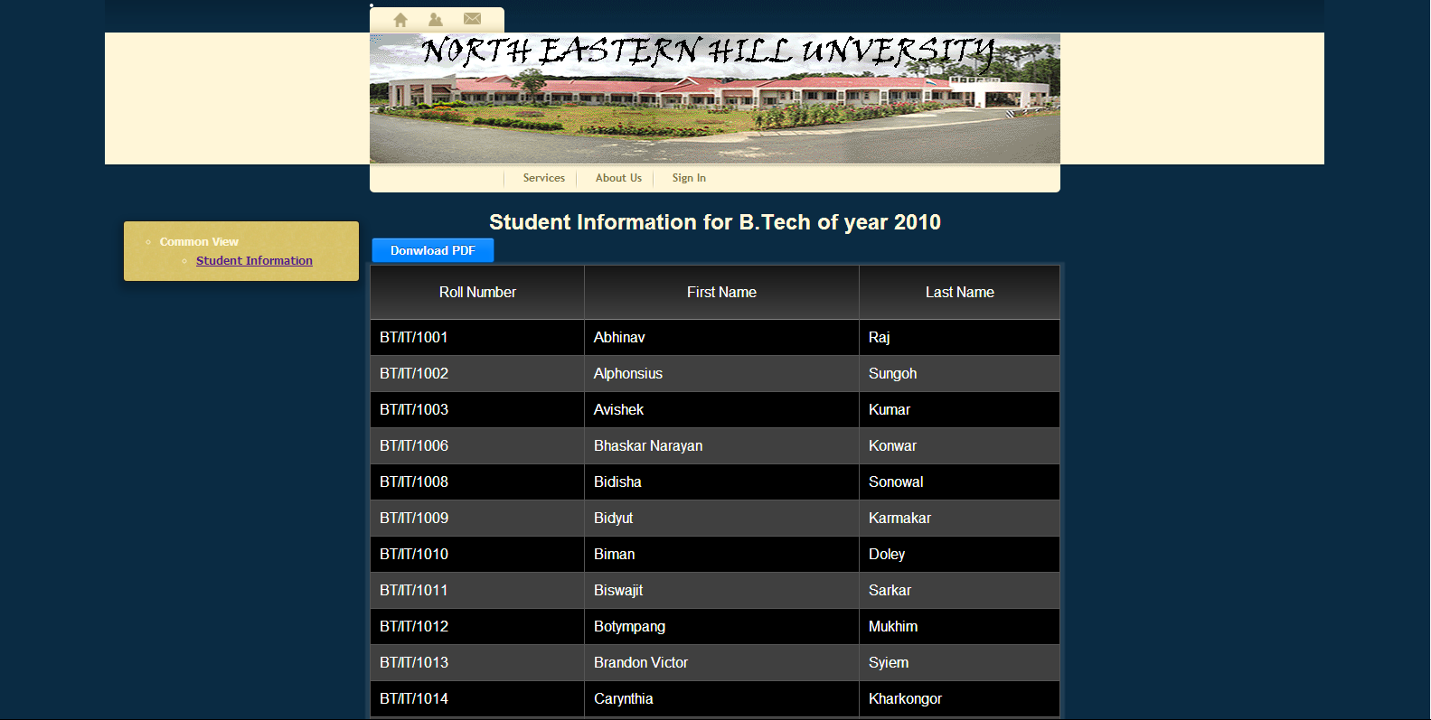
Student Information

Slide 25
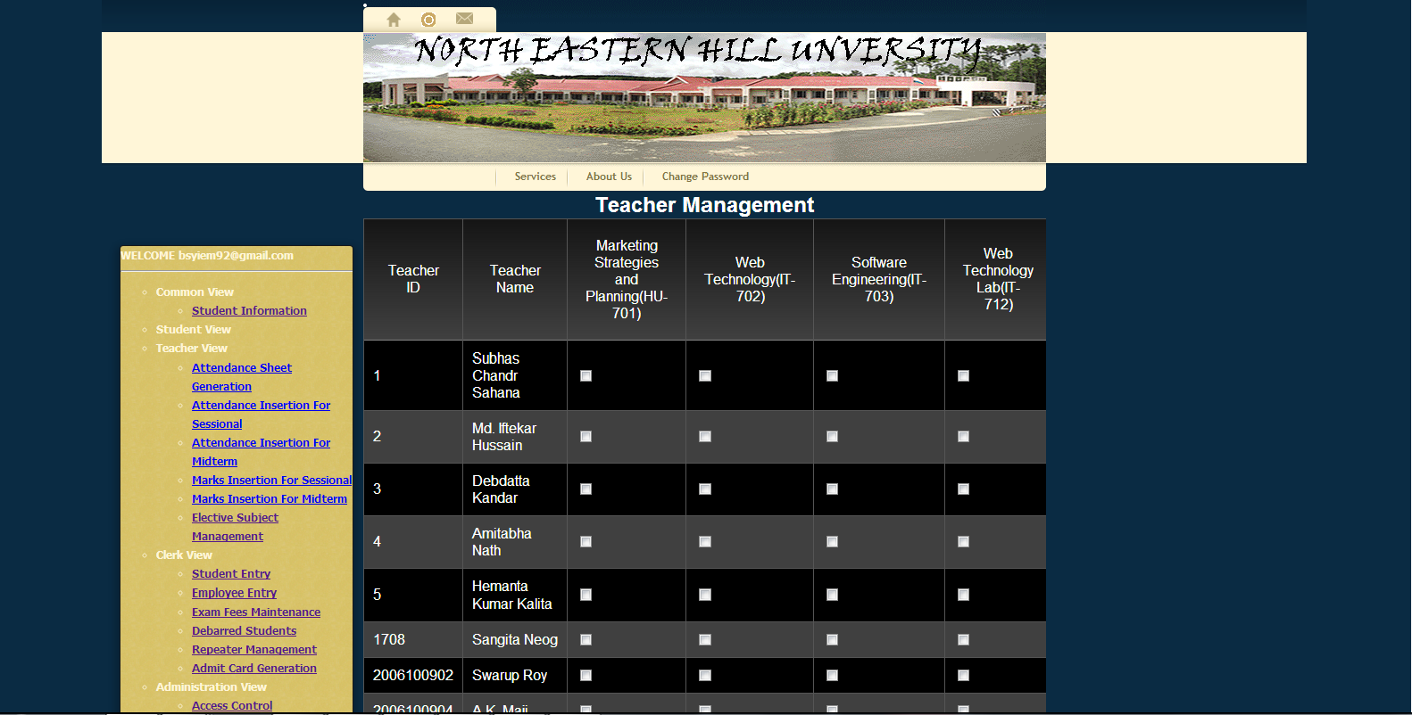
Teacher Management

Slide 26
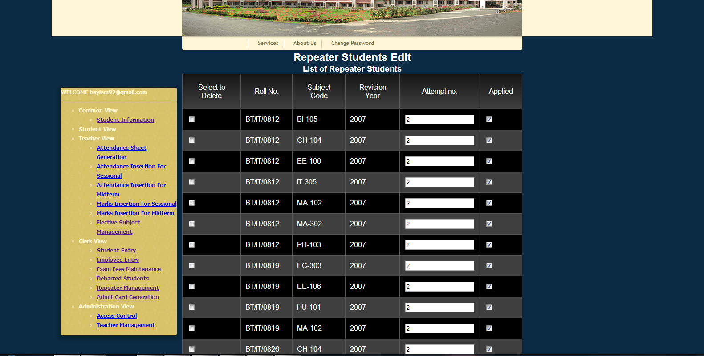
Repeater Management

Slide 27
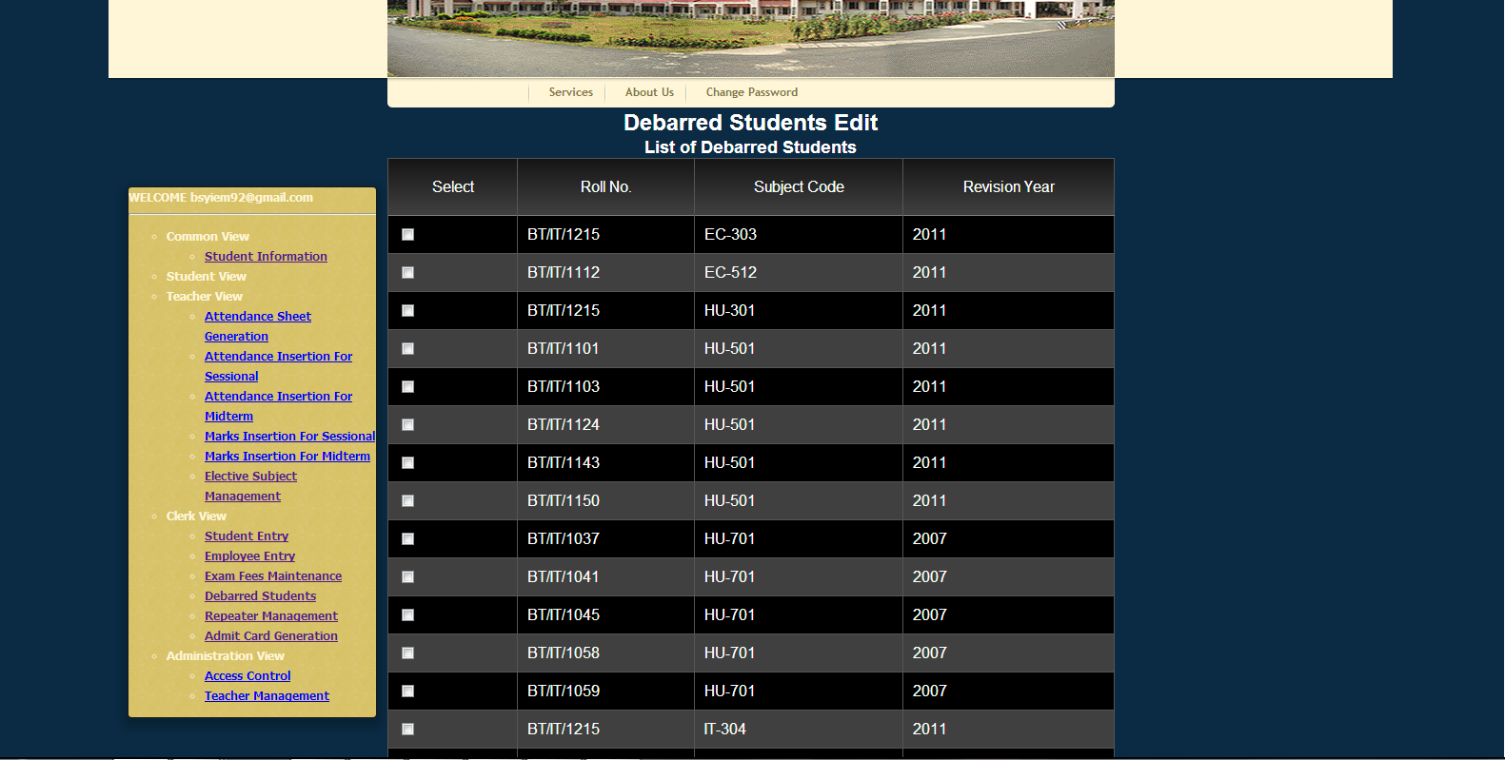
Debarred Management

Slide 28
Security Requirements
Communication Between Client and Server is secured.
The pages are only accessible to the users that have access to the page.
The protected pages are only accessible to logged in users.
Teachers are only allowed to change attendance and marks of students taking their respective subjects.
The text fields only allow valid input.

Slide 29
Conclusion
Our goal was to make an automated system for the department of I.T. And hence we have achieved our goal.
The ISITNEHU may be later adopted and implemented in other departments of the university.

Slide 30
References
Rajib Mall, “Fundamentals of Software Engineering”, 3rd edition, PHI Learning Private Limited, 2010, Pages 86,108-202,323-369.
Henry F. Korth, Silberschatz Abraham and Sudarshan, “Database System Concepts”, 4th edition, The McGraw Hill Companies, 2001.
W. Jason Gilmore , “Beginning PHP and MySQL”, third edition.
Websites:
W3School - http://www.w3schools.com/
StackOverflow-http://stackoverflow.com/
PHP-http://www.php.net/
Ubuntu-http://www.ubuntu.com/
Apache-http://www.apache.org/
MySQL-http://www.mysql.com/
opencodez-http://www.opencodez.com/apache/ssl-certificate- and-install-in-xampp.htm
FrontPage-http://wiki.apache.org/httpd/RewriteHTTPToHTTPS

